Slide 1
MONGOLIA
Bayanjargal Byambasaikhan, Ministry of Mineral Resources and Energy

Slide 2
Energy Sector Overview
Population: 2.7 mln
Electrification Rate: 80%
Population Connected to Grid: 1.8 mln
Deficit in electrical energy:
  Current deficit 0%
  In two years 5%
  In five years 20%
  In ten years 50%

Slide 3
Power Generation
Total Power Generation
4.3 bln kWh
Power Generation Mix
  Coal 91.5%, Oil 5.1%, RE 3.4%

Slide 4
Renewable Energy
RE Policy/ies, highlights:
  RE national program 2005-2020 (RE target)
  RE Law 2007 (Tariff, PPA, Tariff period)
RE Target:
  3-5% of total domestic production by 2010
  20-25% by 2020

Slide 5
Electricity Cost:
Subsidies and Incentives
RE Subsidies
Fossil Fuel Subsidies
RE Source | Base Rate ($/kWh) | Subsidy ($/kWh)
Wind | 0.08 – 0.095 | 0.0 – 0.015
Solar | 0.15 – 0.18 | 0.07 – 0.1
Fossil Fuel | Base Rate ($/kWh) | Subsidy ($/kWh)
Coal | 0.08 | -
Oil | 0.08 | 0.03

Slide 6
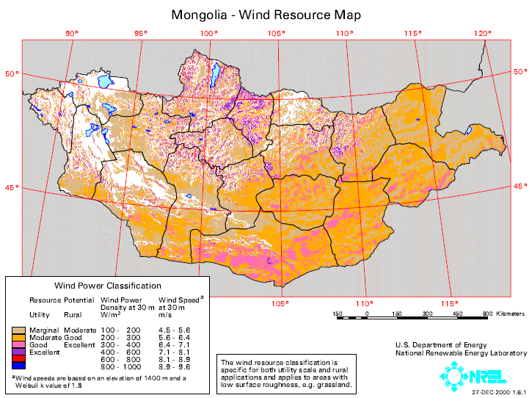
Wind Resource Potential

Slide 7
Total Installed Wind Capacity as of June 2011
Operational Wind Projects | MW | Year
1. Erdenetsagaan | 0.1 | 2004
2. Mandakh, Sevrei, Bogd, Khatanbulag, Tseel, Manlai | 0.7 | 2007
3. Bayantsagaan, Bayan-Undur, Shinejinst, Matad | 0.6 | 2008
TOTAL | 1.4
* Above mentioned are small scale not grid connected, installed in the soum center

Slide 8
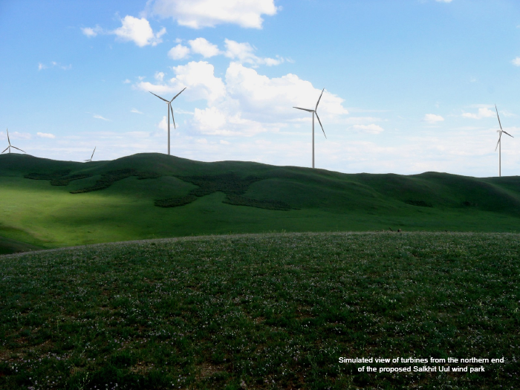
Photo of Wind Farm
Salkhit wind farm

Slide 9
Additional Wind Capacity
Pipeline of Wind Projects | MW | Estimated Year | Estimated Cost
1.Salkhit wind farm (Clean Energy LLC, Newcom Group) | 50 | 2012 | 80 mln USD
2. Khanbogd wind farm (Qleantech LLC) | 250 | 2014 | -
3.Sainshand wind farm (Sainshand) | 52 | 2013 | 80 mln USD
4. Tsetsii wind farm (Clean Energy LLC, Newcom Group) | 200 | 2015 | -
TOTAL | 552

Slide 10
Next Steps
Wind power needed for
  Grid
  Mining power supply
  Export

